Slide 1
Linear Regression Analysis on the Medical Cost Personal Dataset
SBE2240 - Biostatistics
Nouran Mahmoud
Bassmalla Tarek
Salma Ashraf
Yasmin Tarek
Submitted to Professor Ibrahim Youssef
24 June 2023
Team 3

Slide 2
TABLE OF CONTENTS
01
02
03
04
CONCLUSION
INTRODUCTION
METHODS
RESULTS

Slide 3
01
INTRODUCTION

Slide 4

Medical Insurance
An association experiment on the Medical Cost Personal Dataset on the Kaggle platform using linear regression analysis.
The quantitative columns in this dataset are age, bmi, children, and charges. The categorical columns are sex, smoker, and region.

Slide 5
02
METHODS

Slide 6

The Pandas module is imported with the alias pd
Methods: DataFrame
The Pandas module is imported and used to create a DataFrame from a CSV file containing the Medical Cost Personal Dataset.

Slide 7
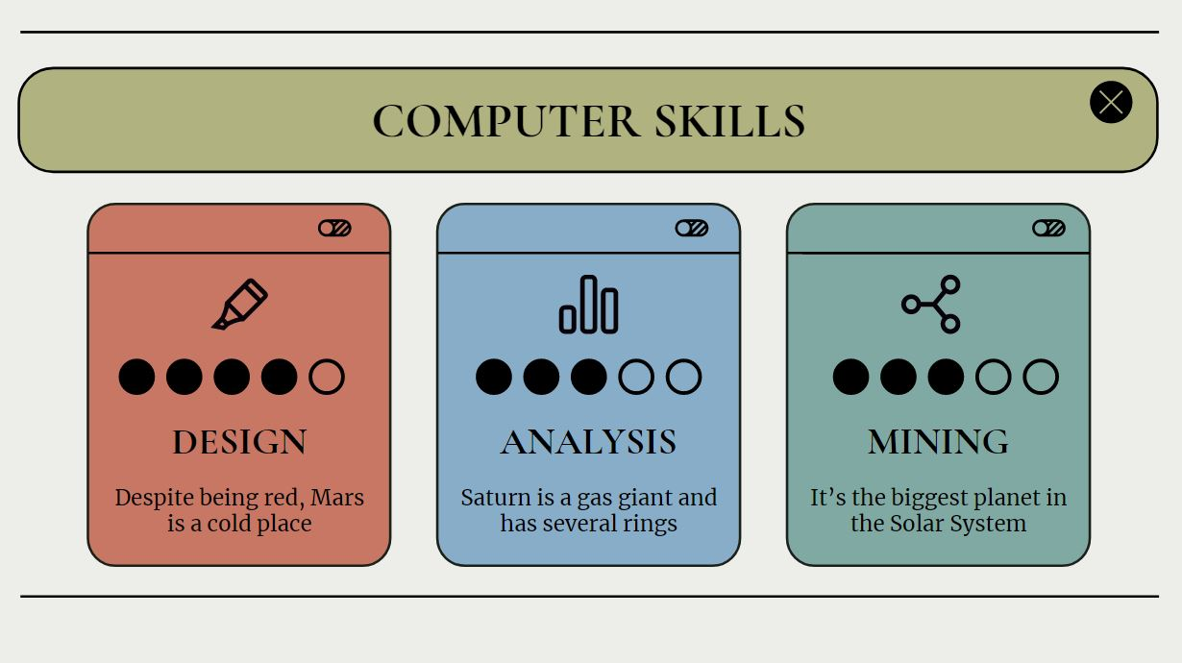
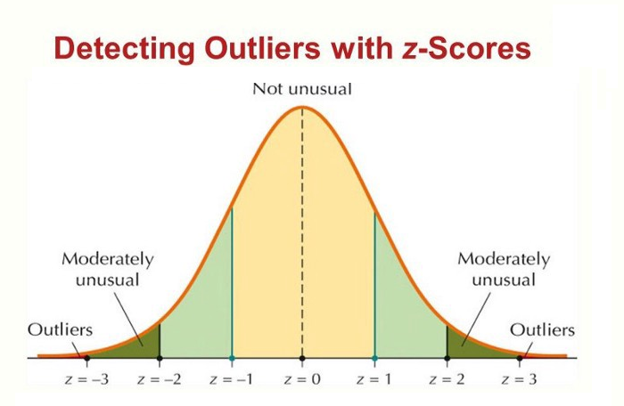
Methods: Removing outliers
The Z-score measures how many standard deviations away from the mean a data point is.
Data points with a Z-score above a certain threshold are considered outliers and removed from the dataset.
A function is defined to calculate the Z-score for each data point in a column of the DataFrame.
The Z-scores for each numeric column are calculated and stored in a new DataFrame.
A boolean mask is created to identify rows that contain outliers.
The mask is used to remove outliers from the DataFrame and create a cleaned version of the data.
Source: Analytics Vidhya

Slide 8
Descriptive statistics
describe()
IQR
Measures of central tendency and dispersion.
Methods: Quantitative description
describe method calculates statistics such as count, mean, standard deviation, minimum, and maximum for each numeric column.
quantile method is used to calculate the 25th and 75th percentiles for each column. The IQR is calculated by subtracting the 25th percentile from the 75th percentile.
mean and 50% are measures of central tendency, while std, min, 25%, 75%, max and IQR are measures of dispersion.

Slide 9
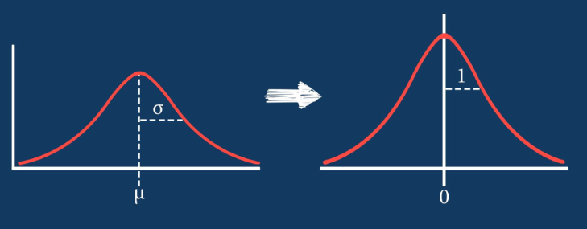
Standardizing the numeric columns in the cleaned DataFrame
Methods: Standardization
A new DataFrame is created as a copy of the cleaned data.
The numeric columns in the new DataFrame are standardized.
Standardization involves calculating the Z-score for each value in a column.
The Z-score measures how many standard deviations away from the mean a value is.
The original values in the column are replaced with their Z-scores.
This process results in a new DataFrame containing standardized data.
Source: towardsai.net

Slide 10
Distribution tests are performed on the ‘age’, ‘bmi’, ‘children’, and ‘charges’ columns in the cleaned DataFrame.
Methods: Distribution tests
Distribution test
Module
Function
Process
Gaussian distribution | scipy.stats | shapiro | The test statistic and p-value are calculated for each column and the p-value is compared to a significance level of 0.05.
Exponential distribution | scipy.stats | anderson | The test statistic is calculated for each column and the test statistic is compared to critical values for different significance levels.
Uniform distribution | scipy.stats | kstest | The test statistic and p-value are calculated for each column and the p-value is compared to a significance level of 0.05.

Slide 11
Results of the three distribution tests performed on the ‘age’, ‘bmi’, ‘children’, and ‘charges’ columns.
Methods: Distribution tests
Age, BMI, children and charges do not follow a Gaussian distribution.
Age, BMI, children and charges do not follow an exponential distribution.
Age, BMI, children and charges do not follow a uniform distribution.

Slide 12
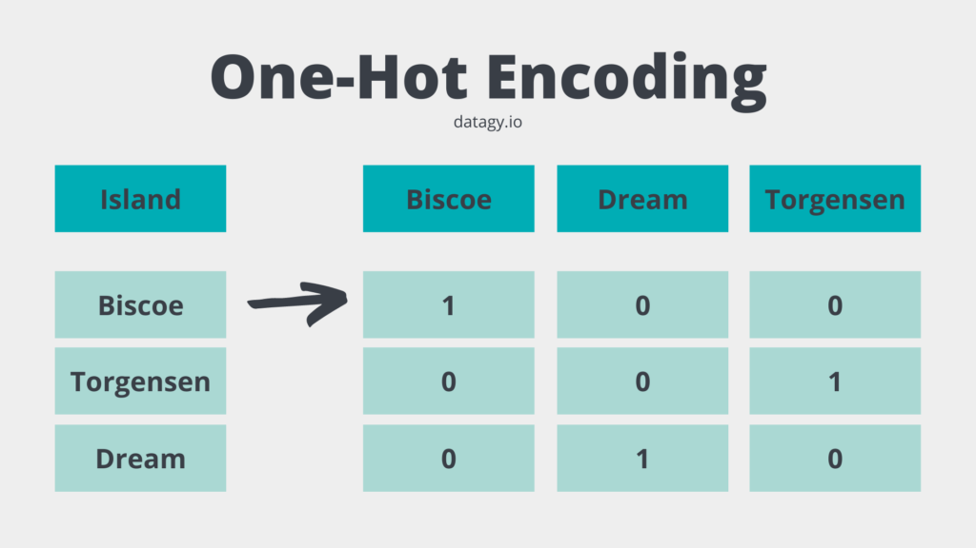
Calculating the correlations between a response variable (‘charges’) and other variables in the DataFrame.
Methods: Correlation coefficients
Categorical variables are one-hot encoded using the get_dummies function from the pandas library.
The correlation matrix of the encoded data is computed using the corr method.
The response variable is set to ‘charges’.
The correlation coefficients for the response variable are extracted from the correlation matrix.

